Slide 1
INFO6003 Lab-09
Sudip Pokhrel
1072933

Slide 2
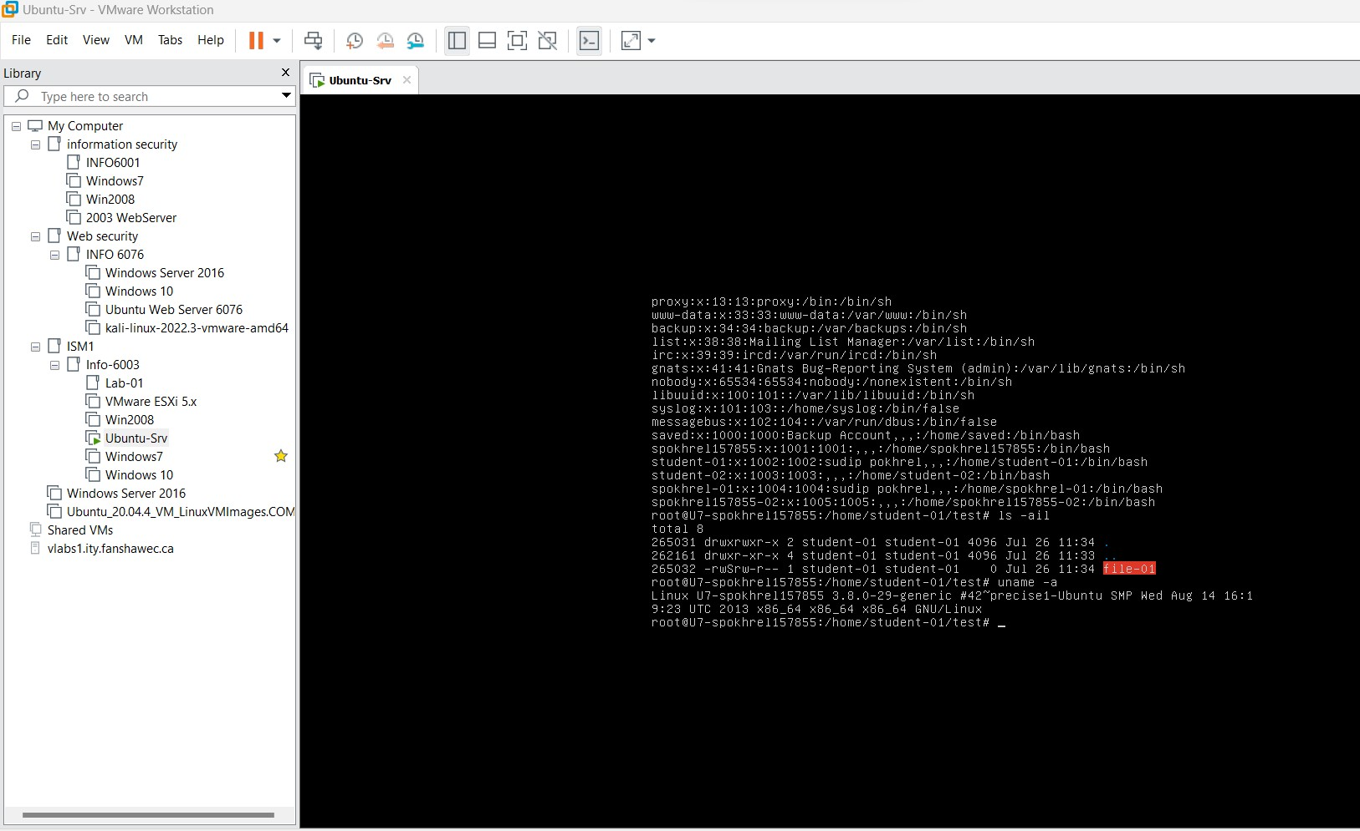
Slide #1

Slide 3
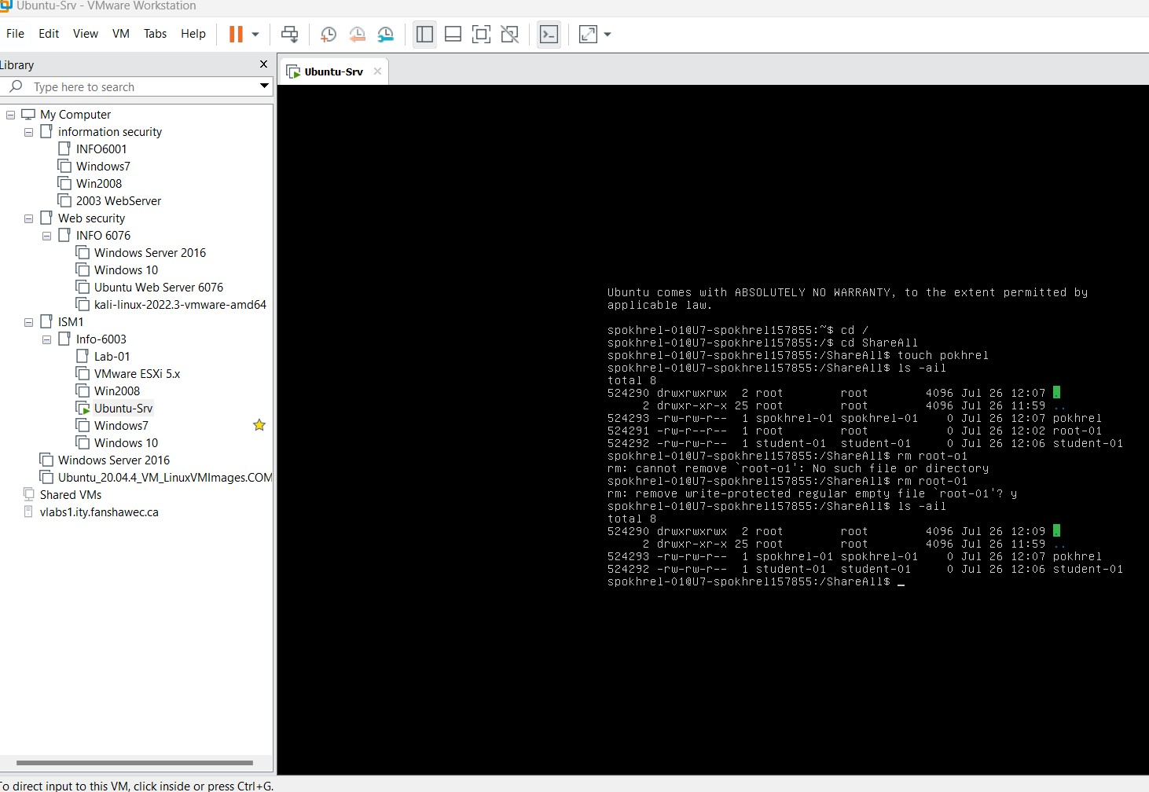
Slide #2

Slide 4
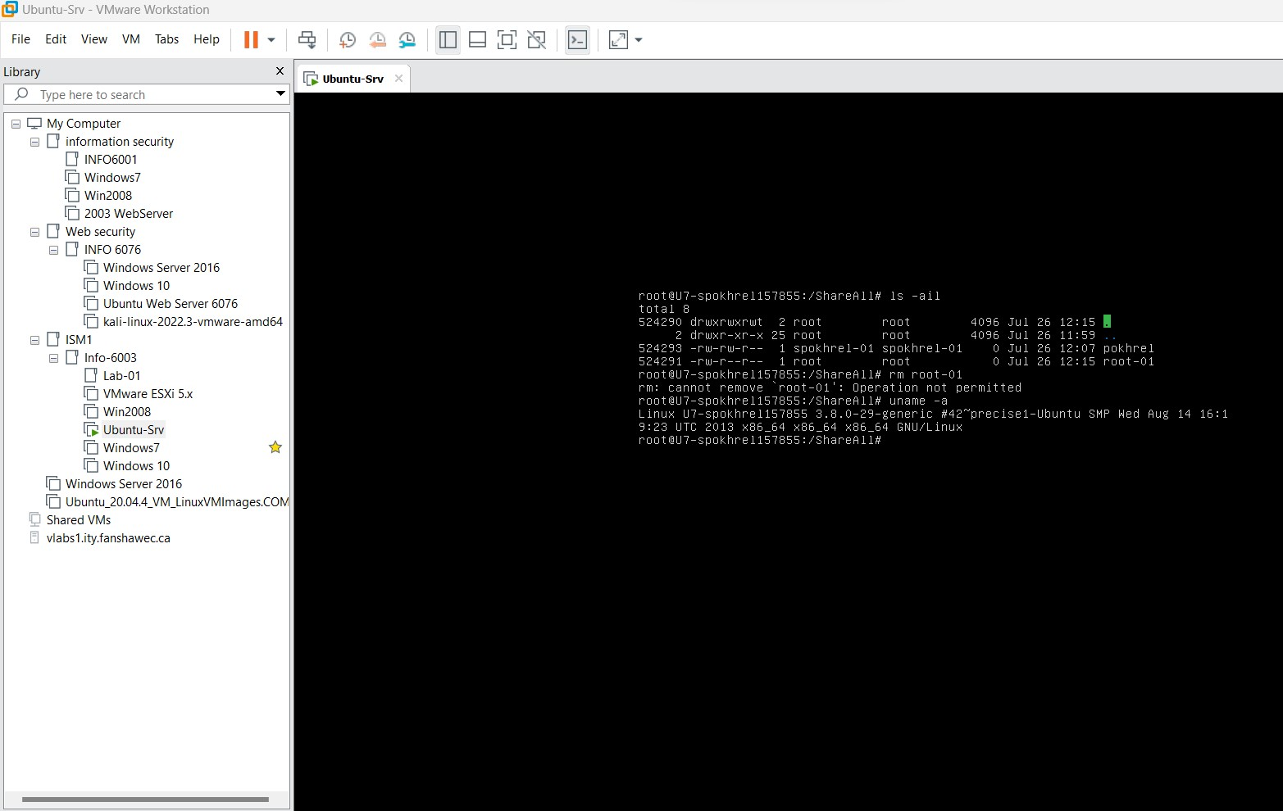
Slide #3

Slide 5
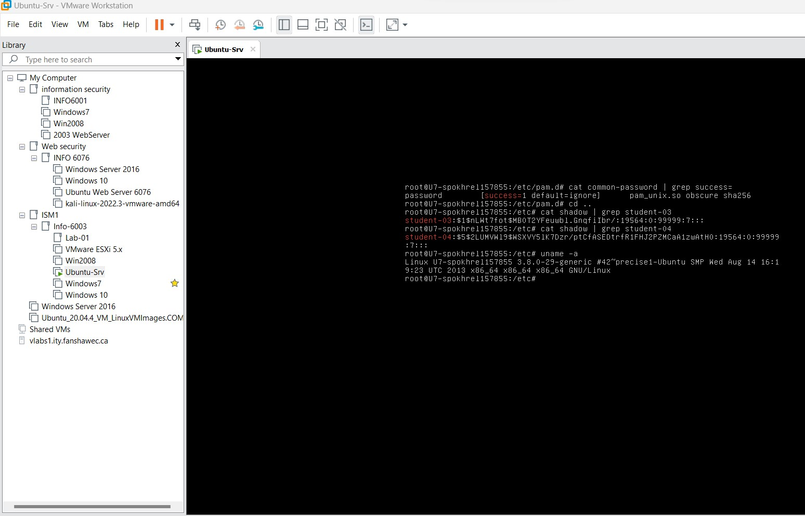
Slide #4

Slide 6
Slide #5
Q) Which directory are you in now? Notice also that the command prompts changes to let us know we have become root. What changes to the prompt can you see?
Ans) Root directory(#)
The user changes from folid@folid to root@folid.
Q) Why is this a capital S instead of a small s?
Ans) s(small)- setuid and executable
S(capital)- setuid and not executable

Slide 7
Slide #6
Q) View the permission on the directory. The t has now been added to denote the sticky bit. Also, note the permission on the tmp directory. Why does that make sense? Ans) The sticky bit on the /ShareAll directory assures that only the file owners can alter or remove their files within that directory, but the sticky bit on the /tmp directory provides a secure and organised environment for shared temporary file storage by numerous users. Q) What happened? Was permission granted? Ans The file was not deleted. Permission was denied. The operation has been cancelled.

